Slide 1
Call for Twinnings
How to Apply Successfully
Practical guidance for eligibility, application package, selection, evaluation and support.
RSCN

Slide 2

HOW TO APPLY SUCCESSFULLY
Eligibility criteria
Who can apply — and what makes an application eligible and strategically credible.
Eligible profiles
Mandatory application logic
Adopter organisation(s) apply jointly with the COMFORTage good practice referent selected for transfer exploration. The same application may include more than one adopter organisation.
Regional/local authorities;
health and social care providers;
hospitals and integrated care networks;
housing and assisted living providers;
community and non-profit organisations;
innovation clusters;
SMEs;
research, policy and public agencies;
DIHs and competence centres.
What is encouraged
Cross-sectoral collaboration, territorial ecosystems, diversity of organisational contexts, sustainability and scalability potential, and openness to collaborative learning.
Best-fit applicant
Apply as an ecosystem when possible: this strengthens feasibility, stakeholder engagement and long-term adoption potential.
An organisation with a defined local challenge in healthy ageing and the capacity to engage stakeholders around a realistic transfer or adaptation pathway.

Slide 3
HOW TO APPLY SUCCESSFULLY
Application process & package
Accessible by design — but specific enough to show motivation, relevance and transfer potential.
A. Expression of Interest Form
B. Short Statement of Motivation
Provide:
organisational profile;
sector and territorial context;
experience relevant to ageing, health or social innovation;
motivation for participation;
indication of interest in specific COMFORTage transferable elements and the related thematic domain.
Briefly describe:
local challenges or opportunities;
key transferable elements identified among COMFORTage Good Practices;
stakeholders and target groups;
expected impact and long-term benefits;
relevance of participation for each applicant;
expectations for knowledge exchange and potential adoption pathways.
Submission instructions
Fill in the dynamic PDF forms available through the call links. The completed documents must be signed by all applicants — adopter organisation(s) and the COMFORTage referent of the selected Good Practice — manually or digitally. Download the dynamic PDF and send it to twinnings@rscn.eu.
Deadline: 03/10/2026
One or more adopters may apply together

Slide 4

HOW TO APPLY SUCCESSFULLY
How to apply successfully
A strong application is specific, feasible and ecosystem-oriented.
Start from the good practice
Engage the referent early
Select the COMFORTage transferable element that best matches your local challenge.
The application must be joint: avoid last-minute signatures and alignment.
Show local relevance
Make transfer credible
Explain the ageing-related need, target groups and territorial context.
Describe organisational, technological and partnership conditions.
Bring stakeholders in
Think beyond the twinning
Demonstrate engagement capacity and ecosystem collaboration.
Include expected impact, sustainability and potential scale-up.
Use the application to tell a transfer story: why this good practice, why your context, why now, and what next.

Slide 5

HOW TO APPLY SUCCESSFULLY
Selection process
A structured and qualitative expert review process identifies applicants with strong transfer potential.
05
05
05
05
05
Submission
Selection
Onboarding
Launch & webinar
Expert assessment
Today
Complete signed package
Qualitative, transparent process
maximum 10 twinnings
COMFORTage Fellow Innovators
What reviewers are looking for
A coherent match between a COMFORTage transferable element, a real local need, motivated organisations, feasible conditions for adaptation and a credible stakeholder ecosystem.

Slide 6
HOW TO APPLY SUCCESSFULLY
Evaluation process & selection criteria
A qualitative, transparent and structured expert review selects organisations with strong participation and transfer potential.
Assessment process
Evaluation criteria and indicative weights
06
Qualitative, transparent and structured review
Relevance to COMFORTage objectives and transferable elements
30%
to identify organisations with strong participation and transfer exploration potential.
06
Expert assessment team
Organisational commitment and motivation
20%
responsible for reviewing and assessing applications.
06
Potential feasibility of transfer/adaptation
20%
Maximum 10 twinnings appointed
as the total ceiling for the programme.
Potential impact on local ecosystems and ageing support services
20%
06
Joint applications allowed
more organisations may apply together for the same good practice, following budgeting instructions.
Capacity for stakeholder engagement and collaboration
10%
Particular attention will be given to:
• diversity of territorial and organisational contexts;
• potential for sustainability and scalability;
• openness to collaborative learning and exchange.
Selected applicants
will join the COMFORTage Twinning Programme and receive the acknowledgement of “COMFORTage Fellow Innovators.”

Slide 7

HOW TO APPLY SUCCESSFULLY
Support package: Phase 1
Online Ambition Building and Transfer Exploration helps adopters clarify objectives, analyse local needs and shape their first transfer ambitions.
Purpose of the workshop
Understanding & prioritisation
A first collaborative online workshop after selection supports the development of a Preliminary Ambition Statement and Scaling-up Plan.
Teams understand transferable elements validated through COMFORTage pilots, analyse local needs and ecosystem conditions, and identify the most relevant elements for adaptation.
Preliminary outputs
Methods & resources
The Ambition Statement and Scaling-up Plan outline the challenge or opportunity, relevant transferable elements, expected local added value, and initial implementation hypotheses.
The workshop includes facilitated peer-to-peer interaction, collaborative exercises, transfer mapping activities, methodological guidance and mentoring support.
Dedicated templates, facilitation materials and supporting documentation are provided.
Phase 1 prepares teams for the site visit and stakeholder exchange.

Slide 8
HOW TO APPLY SUCCESSFULLY
Support package: Phase 2
Site Visit and Local Stakeholder Meeting provides direct exposure to pilot implementation environments and operational stakeholder dialogue.
Co-design of the visit
What the visit aims to achieve
Participants collaborate with the hosting organisation in designing the site visit and local stakeholder meeting.
Observe implementation in practice, engage operational teams, explore barriers and enablers, and validate the preliminary plan through direct exchange.
What to look at
Activities included
Contextual adaptation requirements, organisational feasibility, stakeholder engagement conditions and sustainability considerations.
Operational presentations, pilot demonstrations, stakeholder roundtable discussions and networking sessions.
One agreed study visit per selected twinning team
Outputs feed into revised Ambition Statement and Scaling-up Plan

Slide 9
HOW TO APPLY SUCCESSFULLY
Site visits budget & reimbursement
Indicative costs for one site visit and stakeholder meeting, with reimbursement rules and central financial management by RSCN.
Budget item | Max cost (€) | Additional applicant (€)
Round trips for 2 participants | 1,000 | 1,000
Accommodation (2 participants × 1 night) | 300 | 300
Local transport | 100 | 100
Coffee break (20 participants) | 300 | 50
Light lunch/networking lunch | 500 | 50
Meeting logistics and materials | 100 | 0
Organisational support costs | 200 | 0
Total estimated budget | 2,500 | 1,500
Budget flexibility
Central cost management
The budget may be adapted upon justified request by shifting cost items depending on the hosting location and the number of participants involved.
All eligible costs related to twinning site visits and stakeholder meetings are centrally managed by RSCN. Invoices, receipts and supporting documentation must comply with RSCN administrative and financial requirements.
Reimbursement arrangements
Important rule
Following selection and approval, applicants receive detailed instructions on travel and accommodation arrangements, local transport reimbursement and organisation of the stakeholder meeting hosted by the receiving organisation.
Eligible costs are reimbursed or directly covered by RSCN according to COMFORTage financial rules and the specific guidance provided. No costs should be incurred or committed without prior authorisation from RSCN.
Additional applicants to the same good practice follow the dedicated extra-cost column

Slide 10
HOW TO APPLY SUCCESSFULLY
Key deadlines & pathway
Plan backwards from the submission deadline and leave enough time for partner signatures.
Jul 2026
Early Oct 2026
Oct 2026
Nov 2026
Nov 2026–Jan 2027
Feb 2027
Mar–Apr 2027
May–Jun 2027
Today
Application deadline
check final form
Evaluation
and selection
Notification
Workshop 1
Site visits
stakeholder meetings
Intermediate
online symposium
Final transfer
plans
Final symposium
Brussels
PHASE 3
PHASE 4
PHASE 5
Submission deadline: practical note
Working backwards
Allow time to identify the right good practice, contact the COMFORTage referent, align adopter organisations, finalise the Motivation Statement and collect all signatures.
The timeline in the call indicates 6 October 2026, while the application instructions show 03/10/2026. For a safe process, communicate an internal deadline before 3 October and confirm the official date at launch.

Slide 11
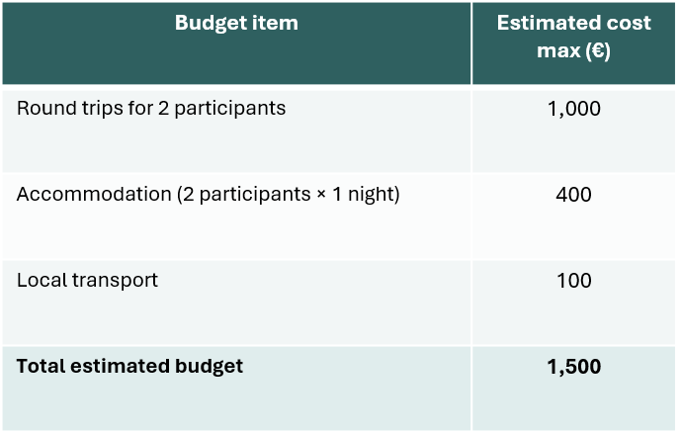
HOW TO APPLY SUCCESSFULLY
Final Symposium budget
Indicative budget available for participation in the final COMFORTage Twinning Symposium.
Budget scope
The budget covers the participation of 2 participants in the Final Symposium, including travel, accommodation and local transport.
Round trips
Maximum estimated cost: €1,000 for round trips for 2 participants.
Local transport
Accommodation
Maximum estimated cost: €100 for local transport.
Maximum estimated cost: €400 for accommodation for 2 participants × 1 night.
Total estimated budget: €1,500
Budget item reference for the Final Symposium

